Slide 1
A Smart Phone Application for Valet Parking
LUO Xianyang, XU Xiaodong, Supervised by Dr. Chim

Slide 2
Outline
Introduction
Relative Works
Design
Implementation
Future Plan
Demo

Slide 3
Introduction
Why valet parking
Project description
Disadvantages of traditional valet parking

Slide 4
Why Valet Parking
Do not need to find a parking lot
Do not need to walk a long distance
Less Stress, Secure and avoid traffic flow
Park more vehicles into a given space

Slide 5
Disadvantages of traditional valet parking
Must use a parking ticket
Time to fulfill the ticket
May lose the ticket
May not know the drop-off point
Must drop off or return at a certain location
Do not know where the vehicle is parked and the status
Pay in cash or octopus

Slide 6
Project Description
This project mainly focuses on helping drivers enjoy better valet parking service with high efficiency and great user experience
Main functions
Sign Up / Sign In / Reset password
Real time locations of client, valets and vehicle
Place an order in a few seconds by tapping a single button
Detection of vehicle license plate, vehicle model and vehicle color
Apple pay
View all the historical orders

Slide 7
Relative Works
Luxe
Youbo

Slide 8
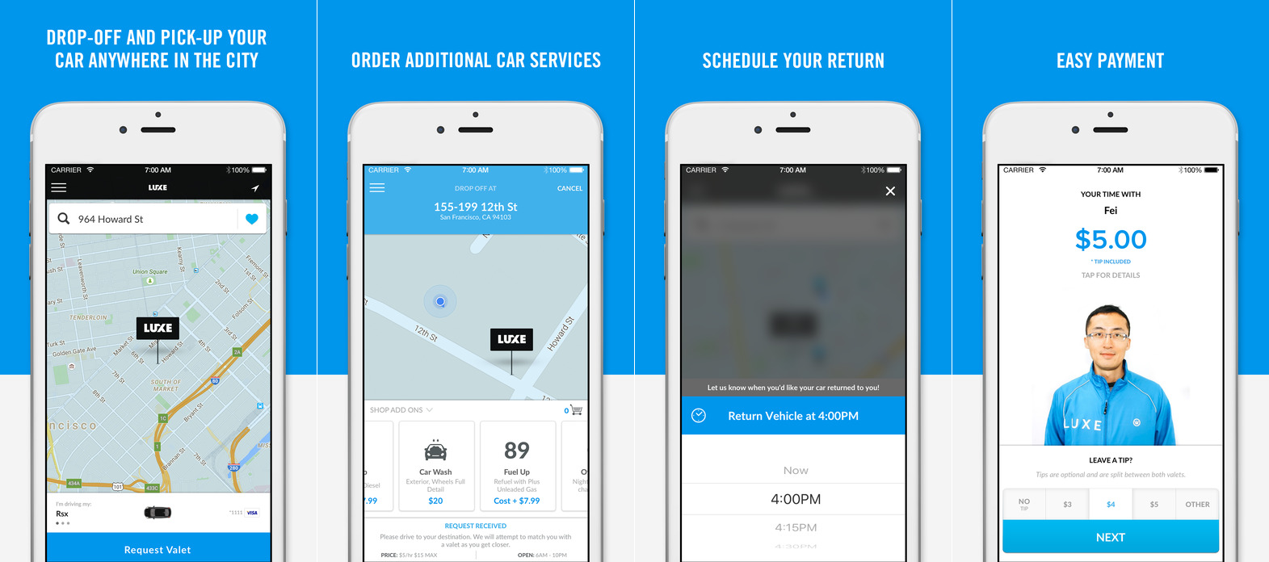
Luxe
Advantages
Drop off anywhere
Mobile payment
Additional service (wash, refuel)
Disadvantages
Registration process is complicate
No identity authentication
No vehicle status
Notes:
iOS / Android, the USA

Slide 9
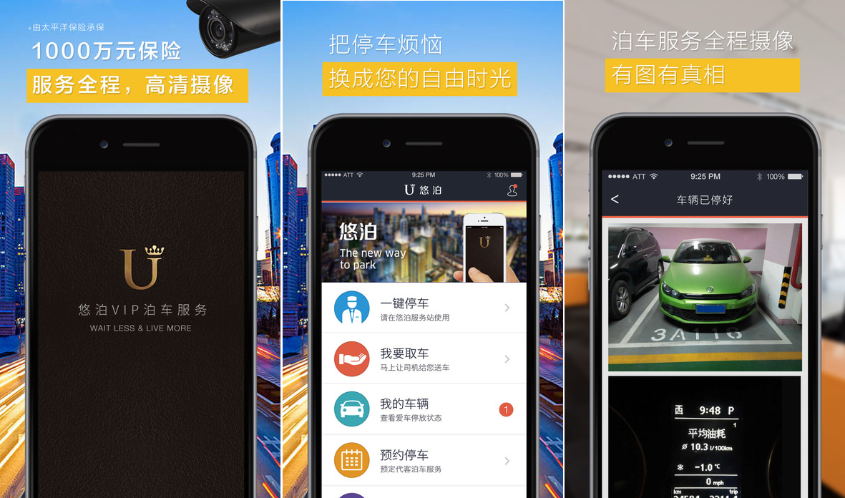
Youbo
Advantages
Get the car returned wherever customer wants
Additional service (wash, refuel)
Show car status
Disadvantages
User interface not so good
No navigation
No identify authentication
Notes:
iOS / Android, mainland China

Slide 10
Design
System Architecture
Workflow
UML Analysis
Use case diagram
Class diagram
UI design
Welcome pages
Main function pages

Slide 11
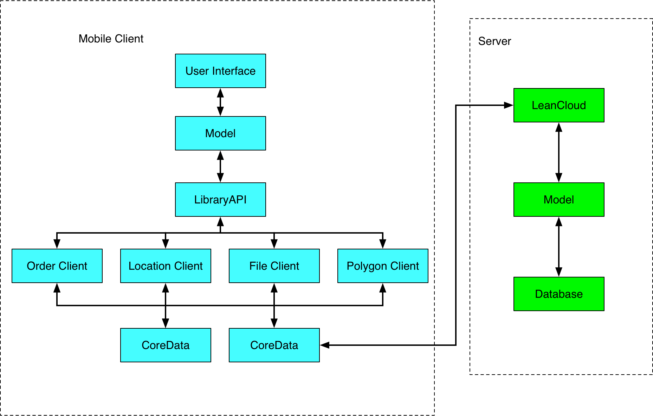
System Architecture
Notes:
Two sides: front-end and back-end. Back-end is based on Node.js and MongoDB

Slide 12
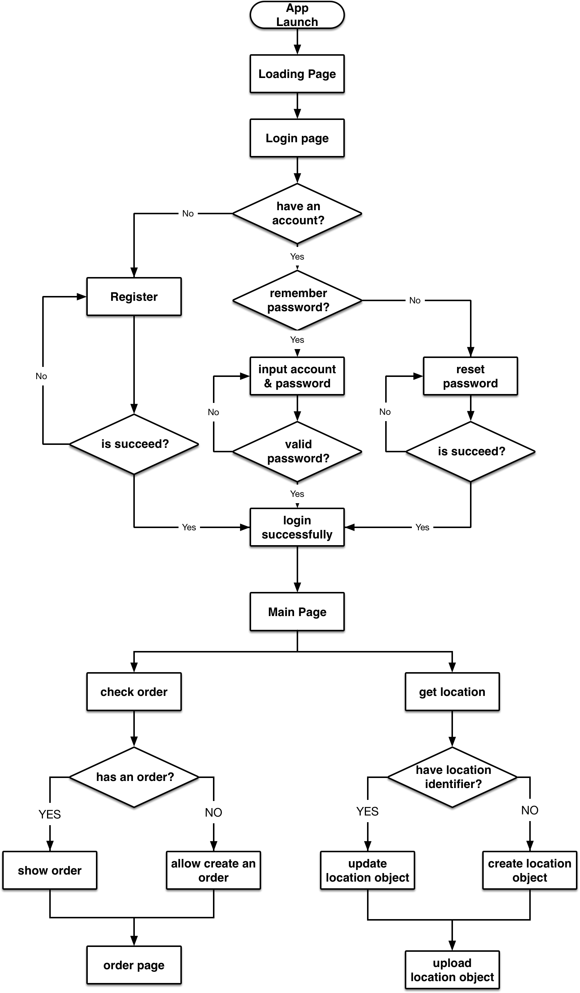
Workflow

Slide 13
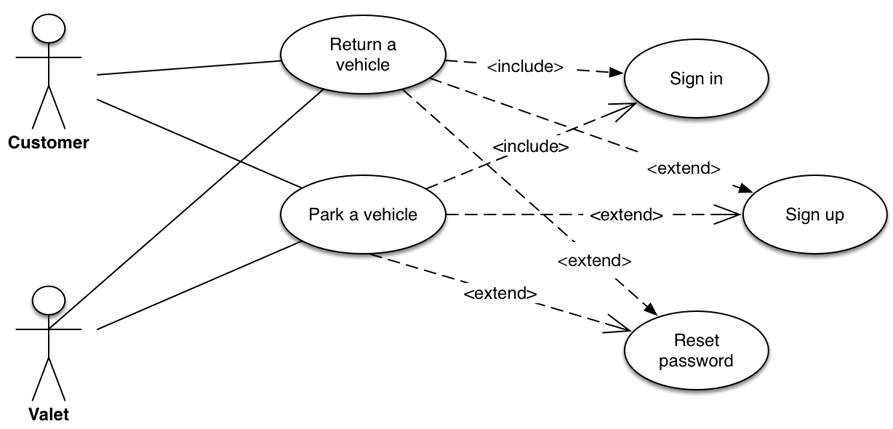
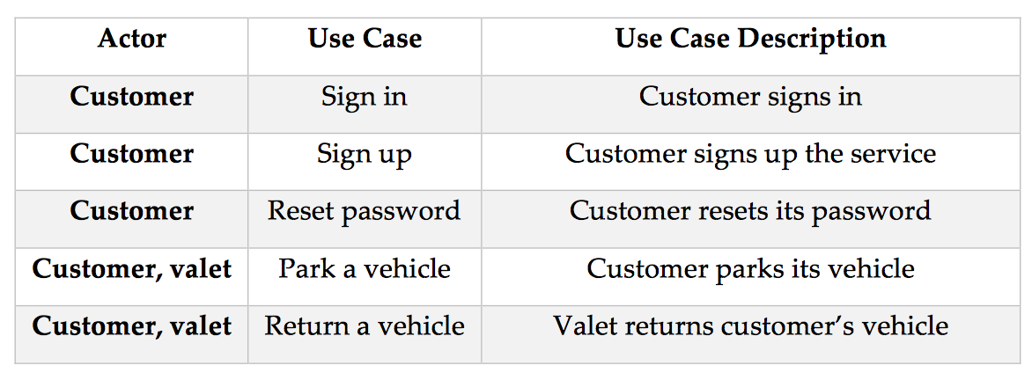
Use Case Diagram

Slide 14
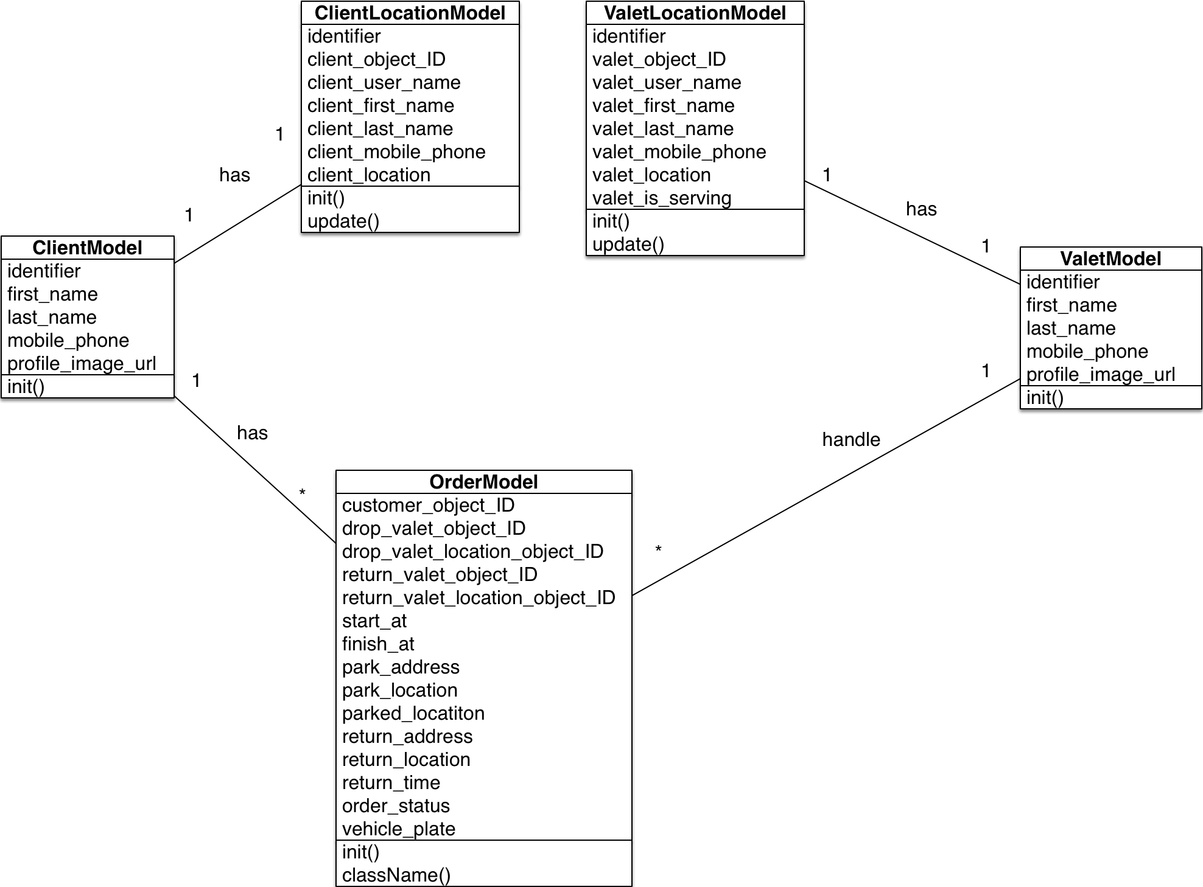
Class Diagram

Slide 15
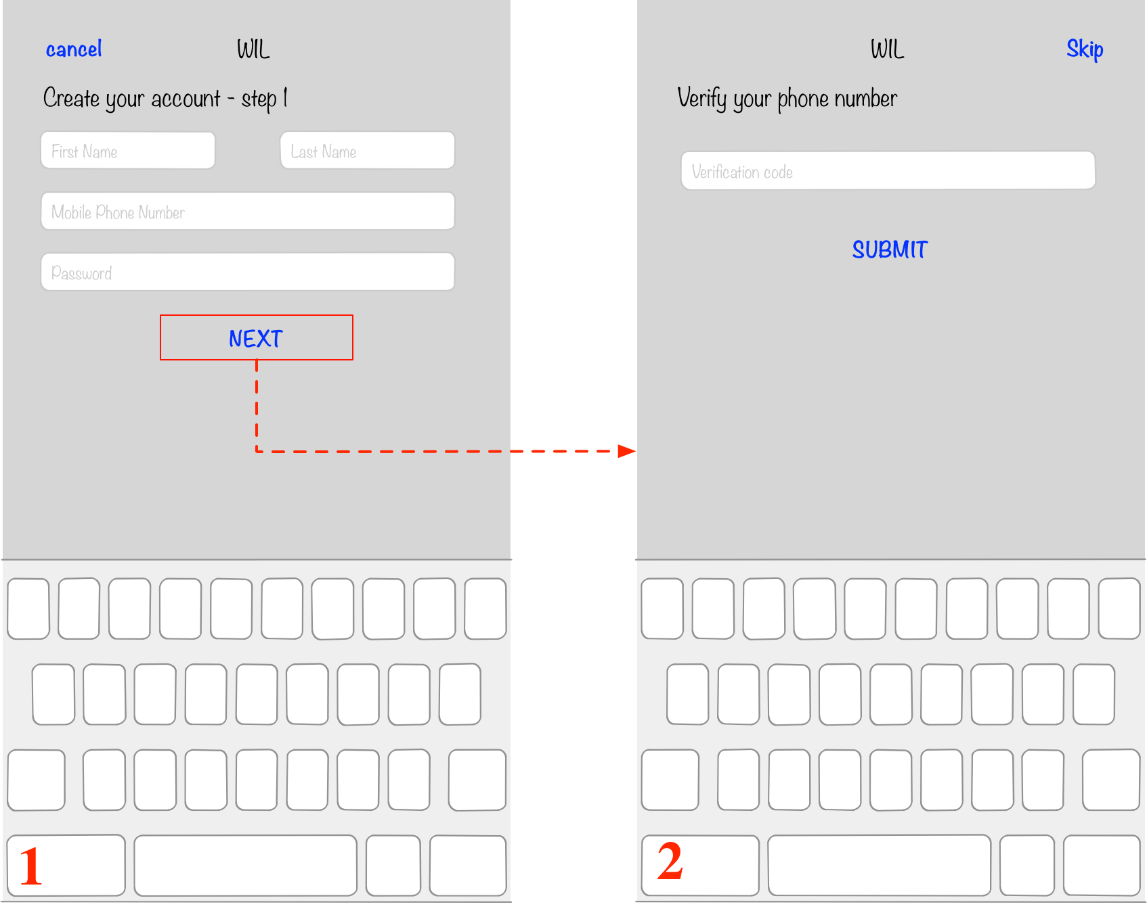
UI Design – Sign Up Pages

Slide 16
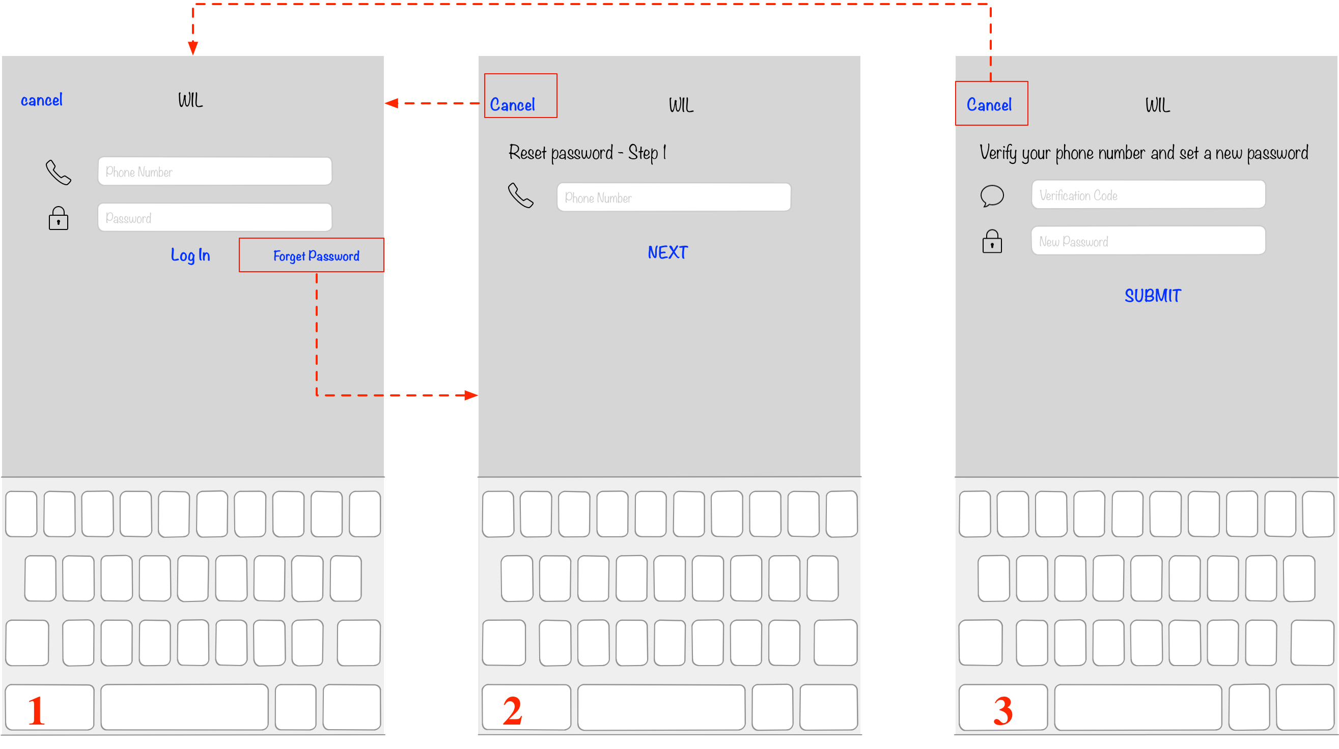
UI Design – Sign In page and Reset Password Pages

Slide 17
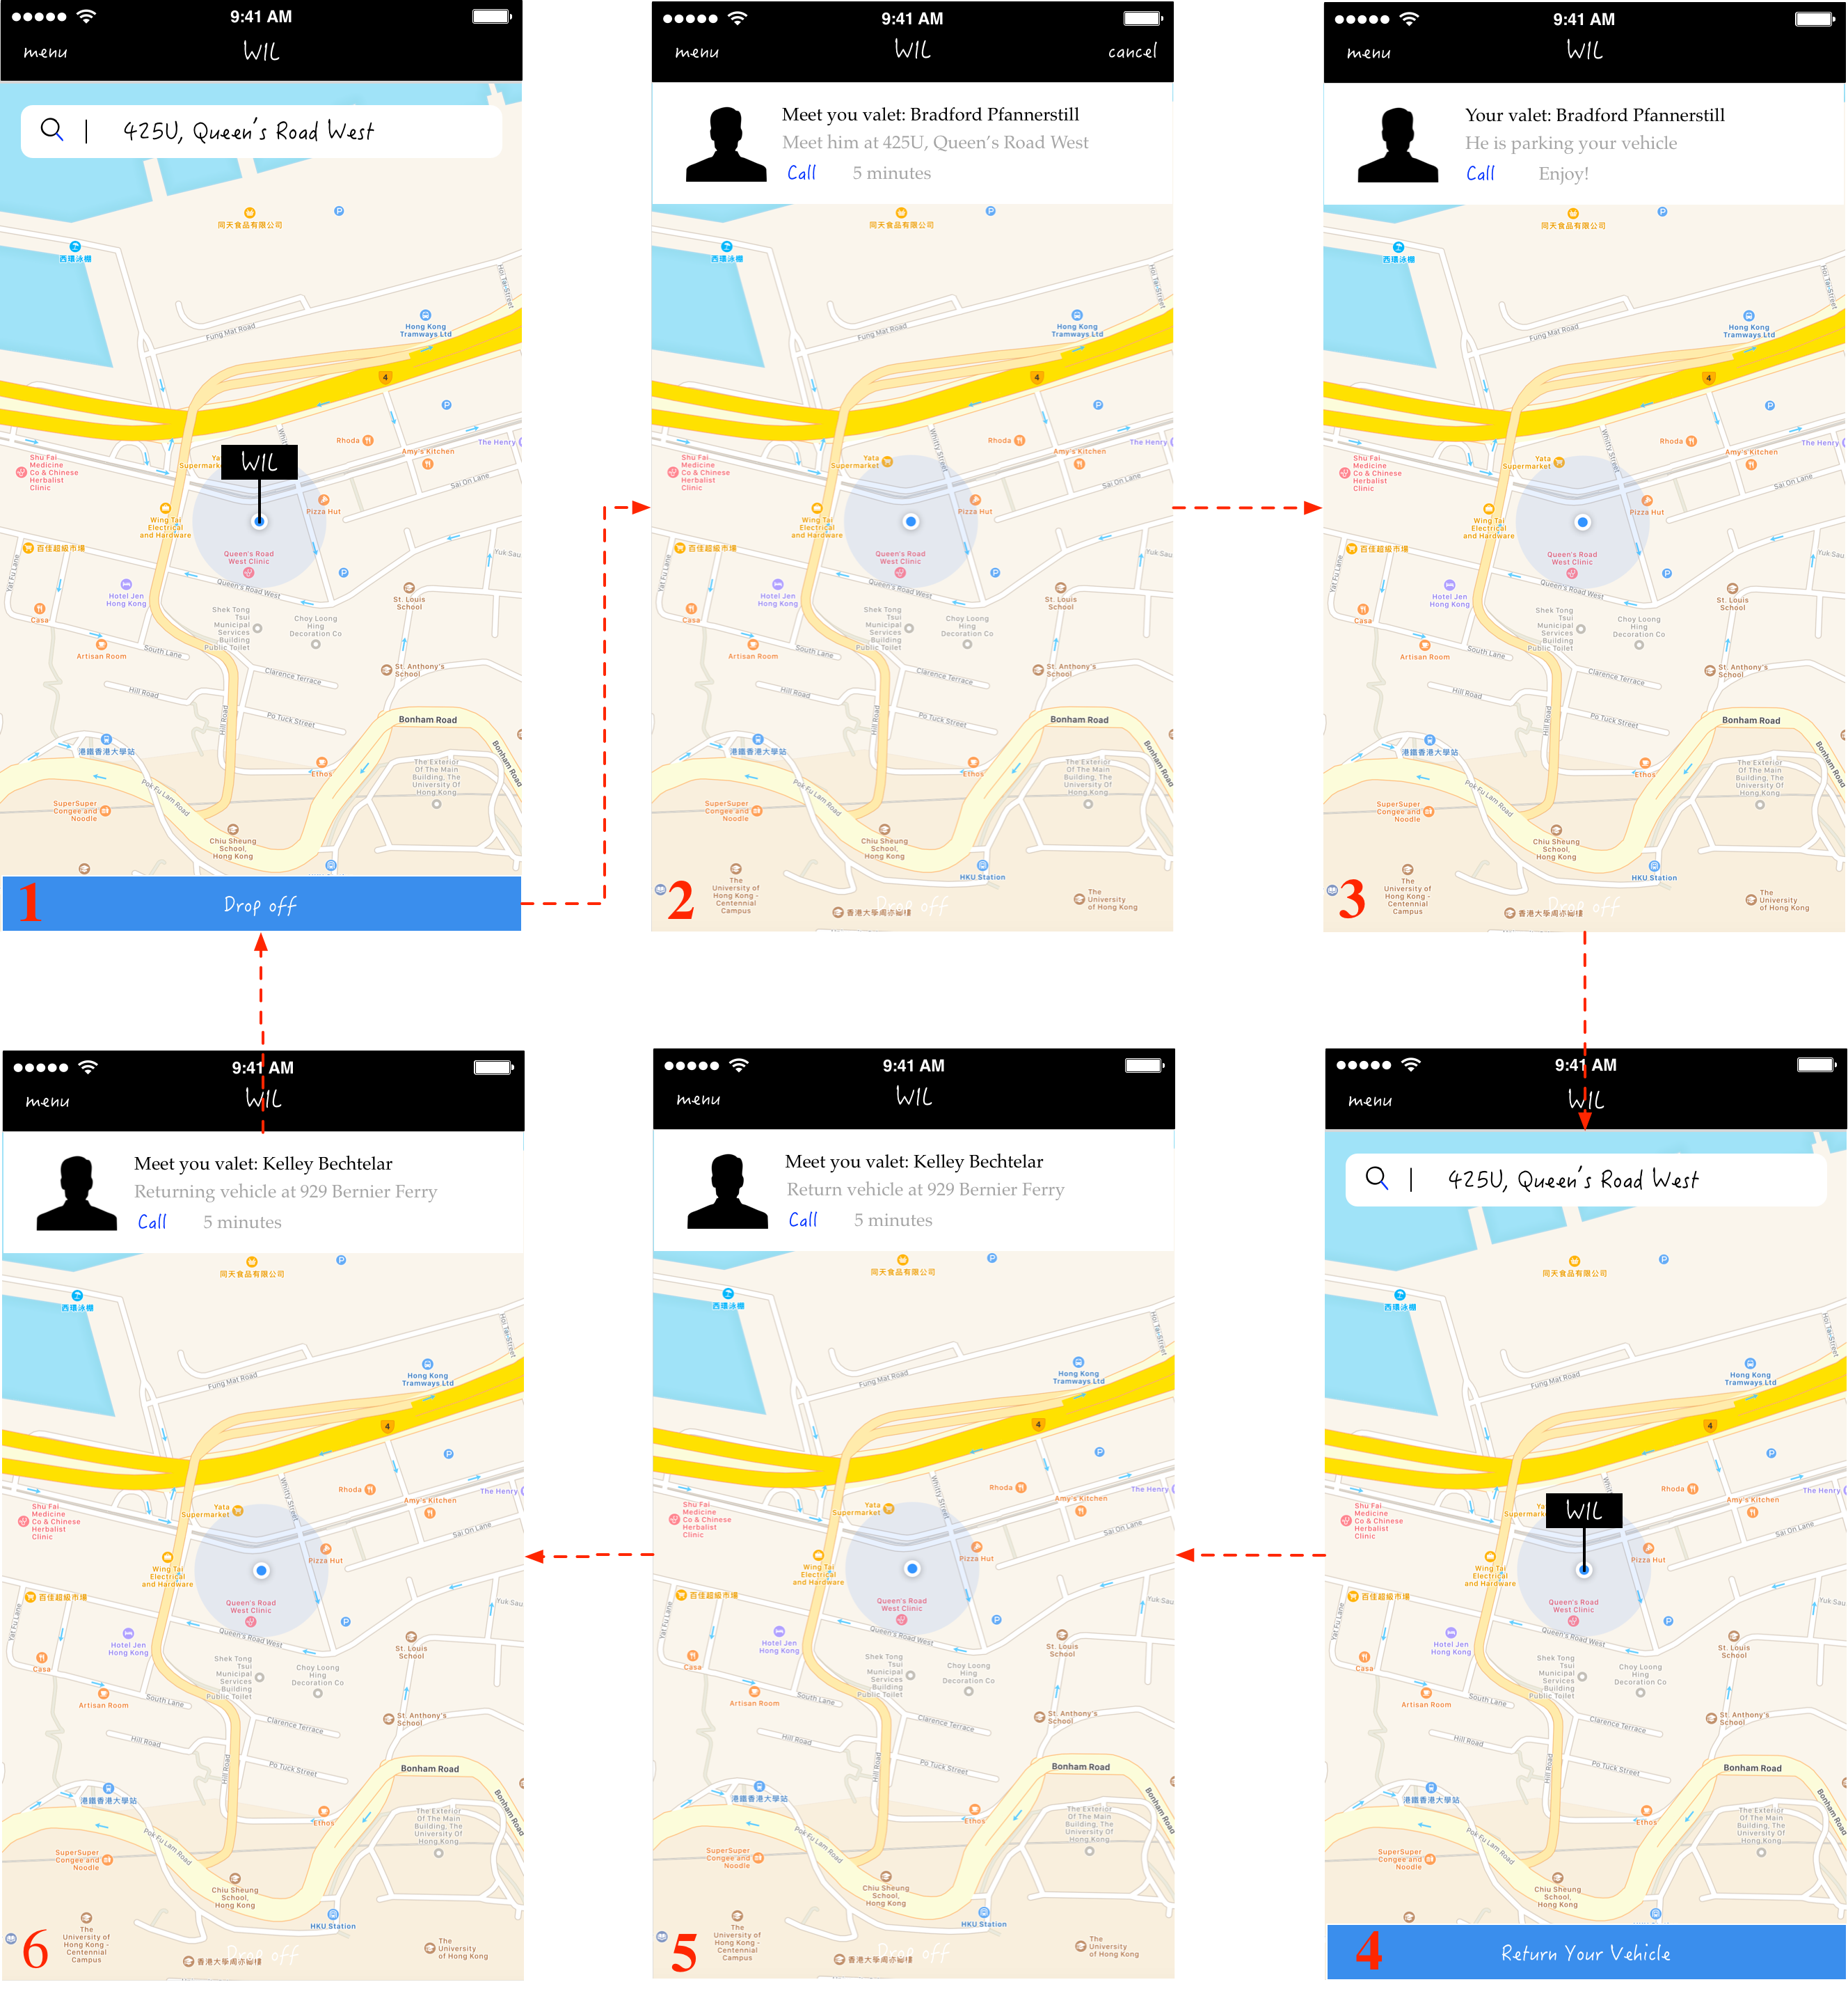
UI Design – Main Function Pages (Customer)

Slide 18
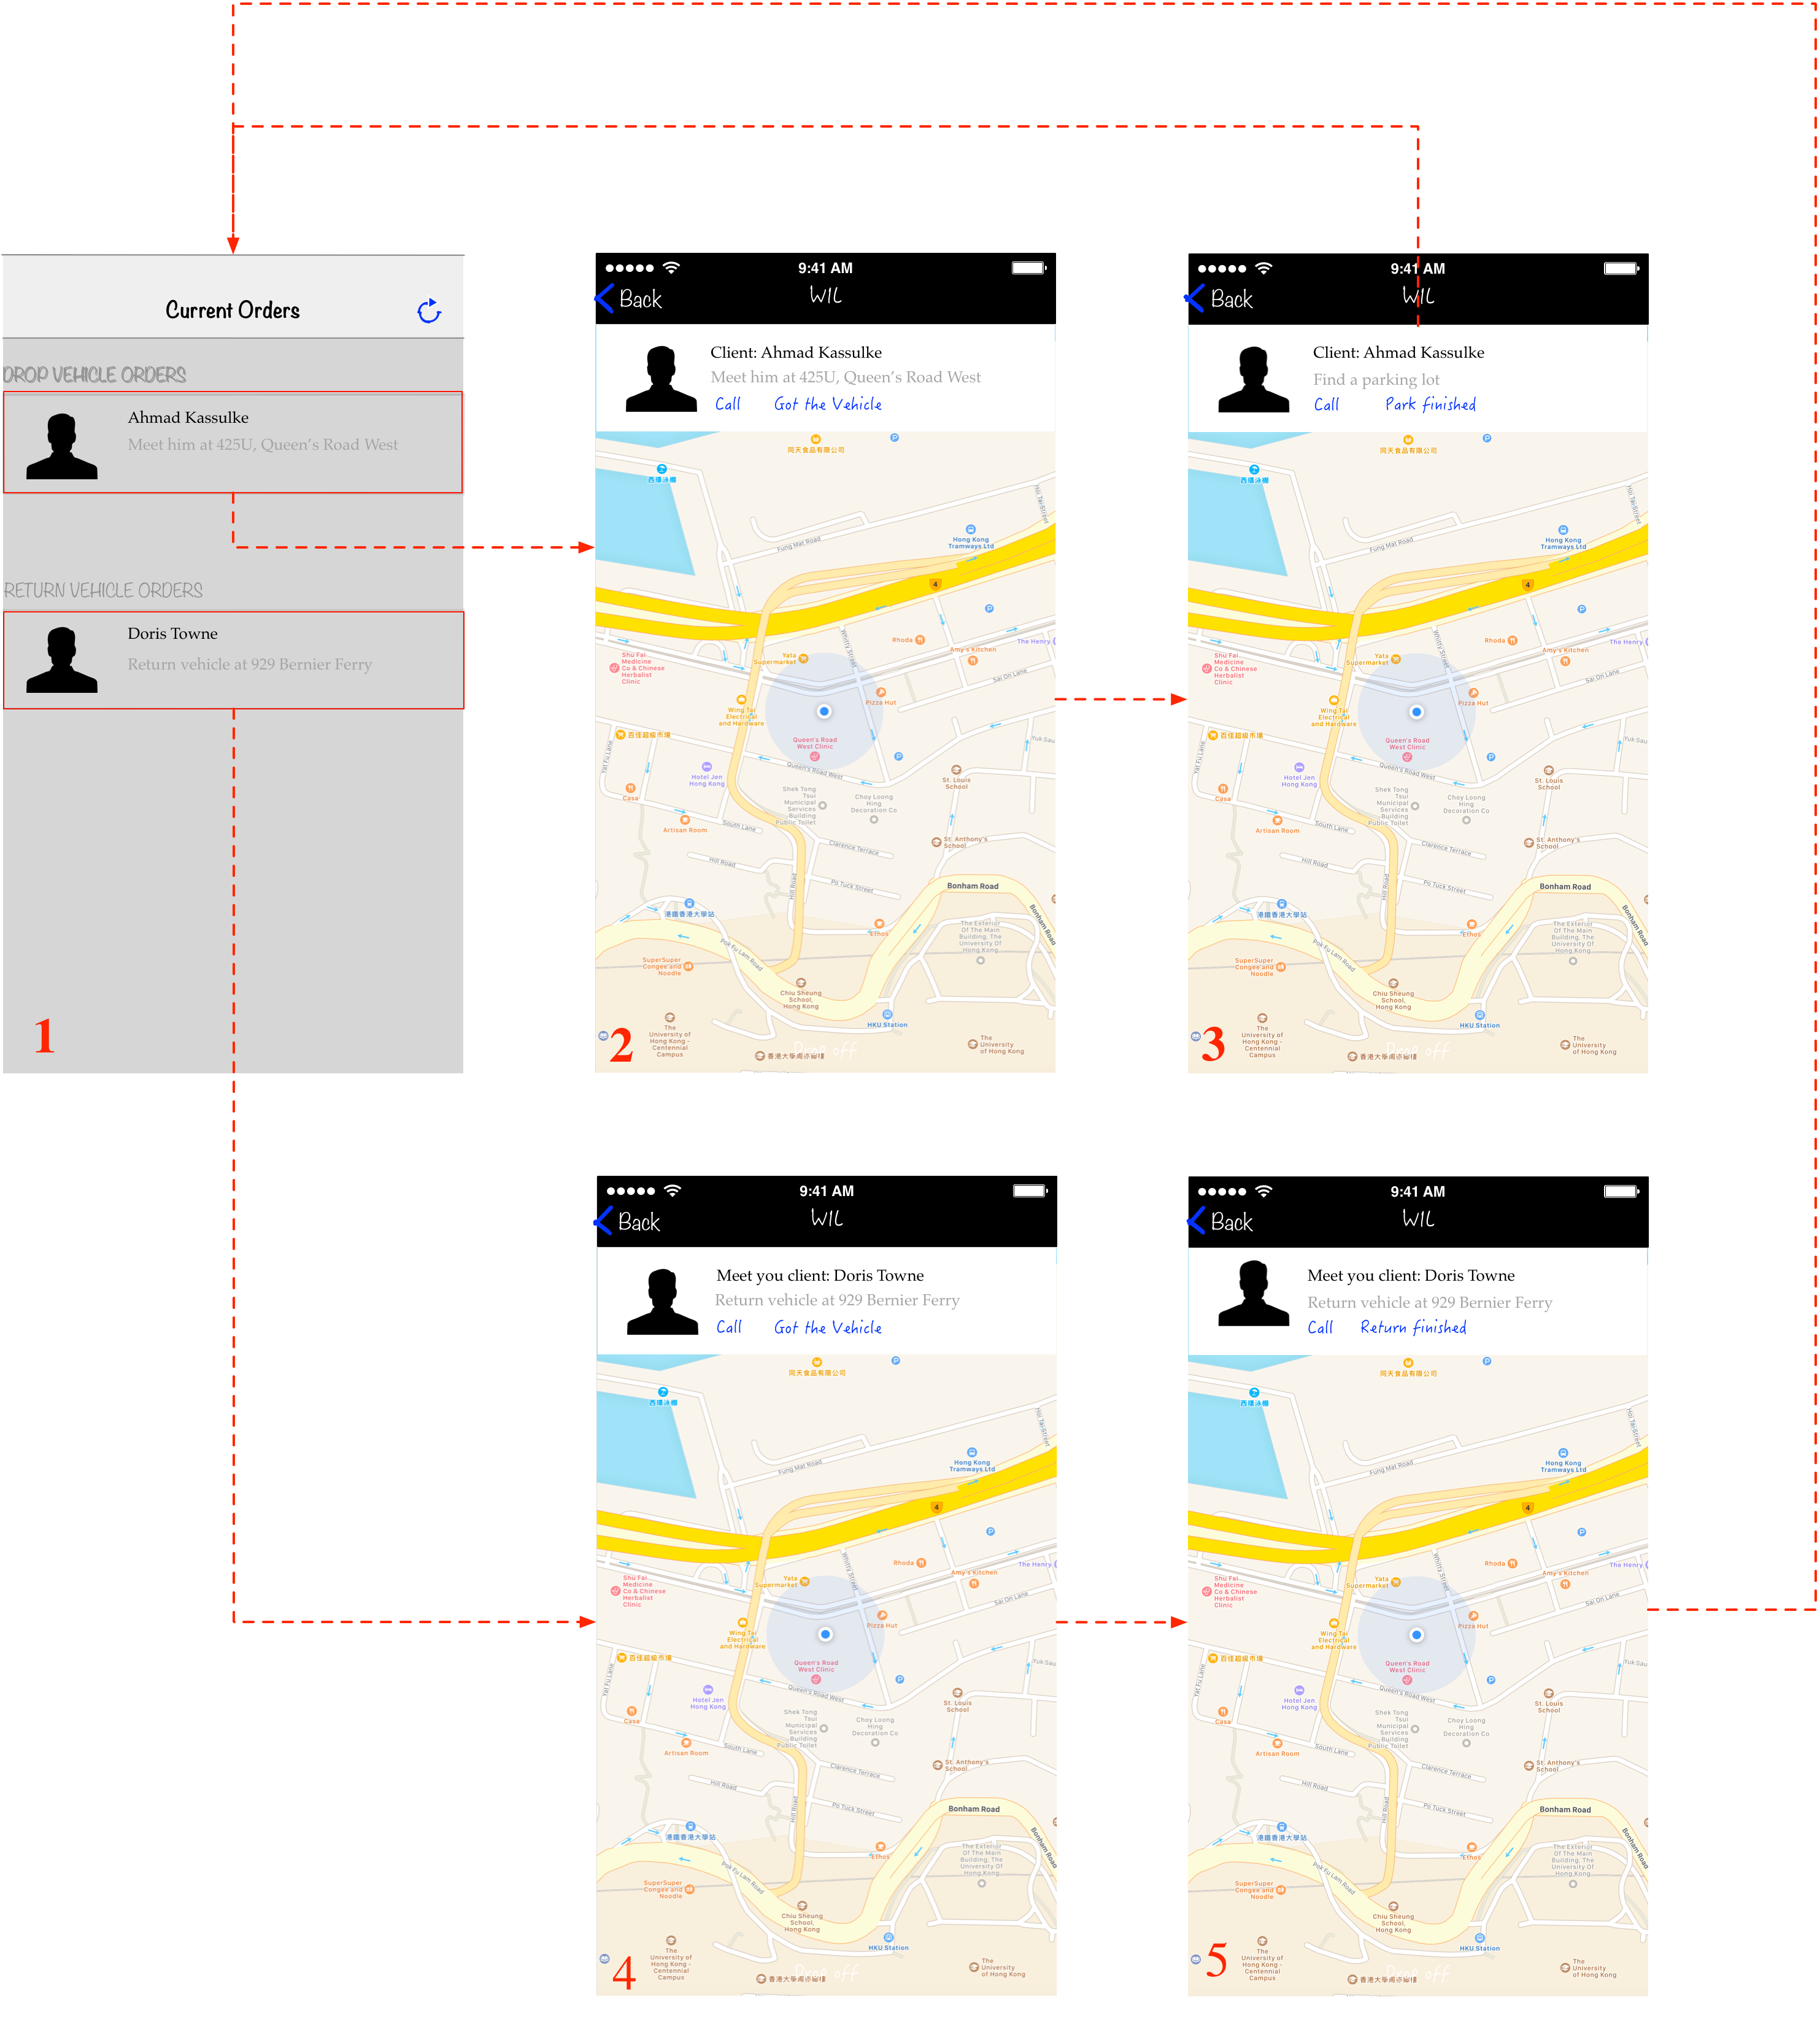
UI Design – Main Function Pages (Valet)

Slide 19
Implementation
Hardware Configuration
Implementation of mobile clients
Customer side
Valet side
Implementation of server

Slide 20
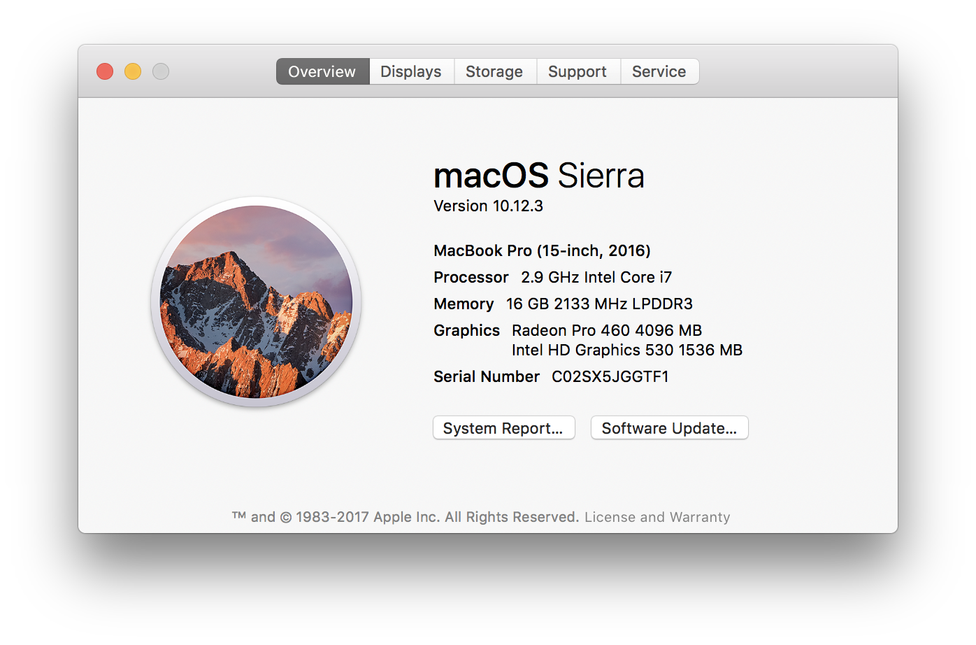
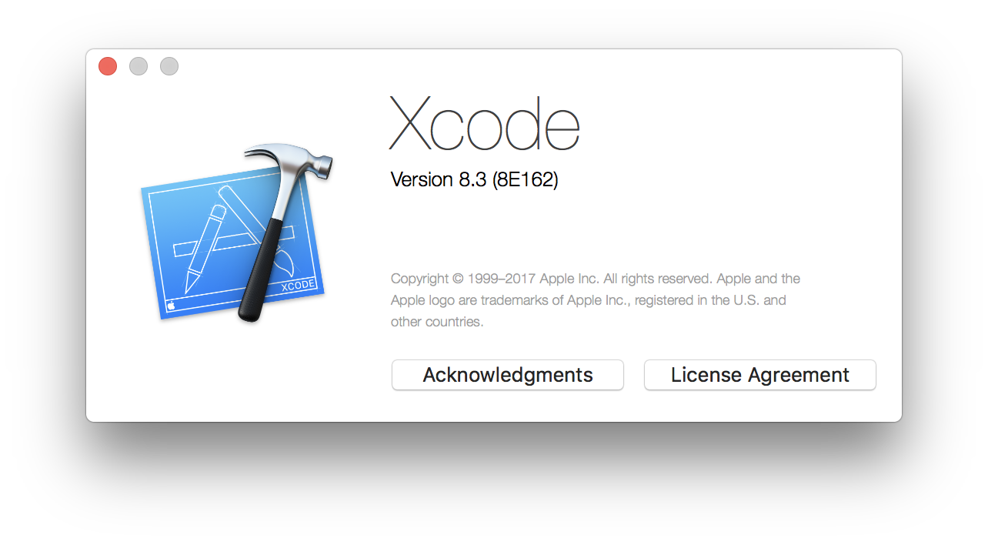
Hardward Configuration

Slide 21
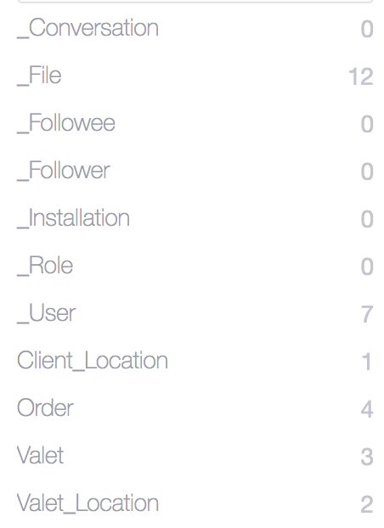
Implementation of Back-End
LeanCloud
The server of this project is based on LeanCloud which offers server and database service

Slide 22
Implementation of Customer Client
MVC design pattern
Controllers
Models
Views

Slide 23
Main Controllers
LibraryAPI inherits from NSObject and handles all the data request
Class method sharedInstance().
Example: [[LibraryAPI sharedInstance] getCurrentUserModel];
LocationClient handles customers’ locations and valets’ locations
OrderClient can create, fetch, update order
PolygonClient handles service area and create route
FileClient can upload and download files

Slide 24
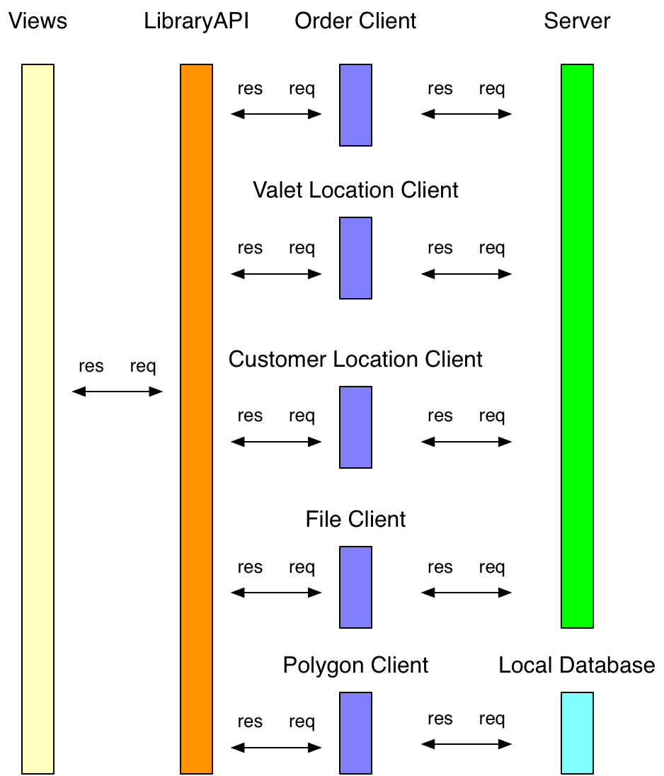
Main Controllers

Slide 25
Models
Customer Model
Valet Model
Order Model
Customer Location Model
Valet Location Model
Valet Marker

Slide 26
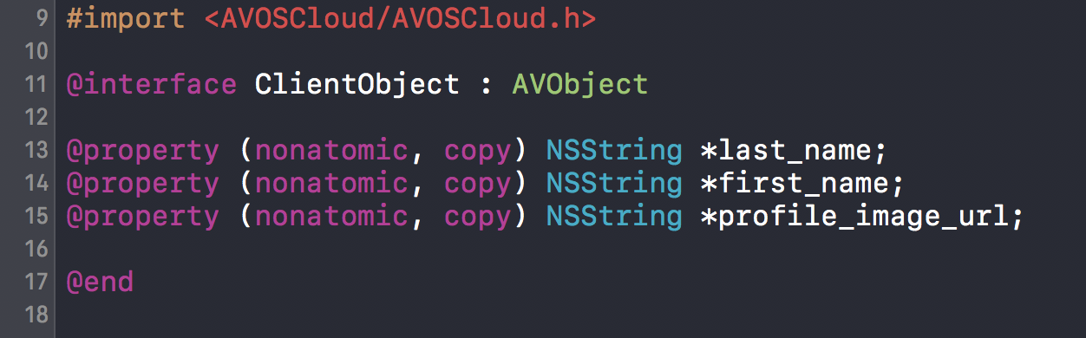
Models
All models inherit from AVObject

Slide 27
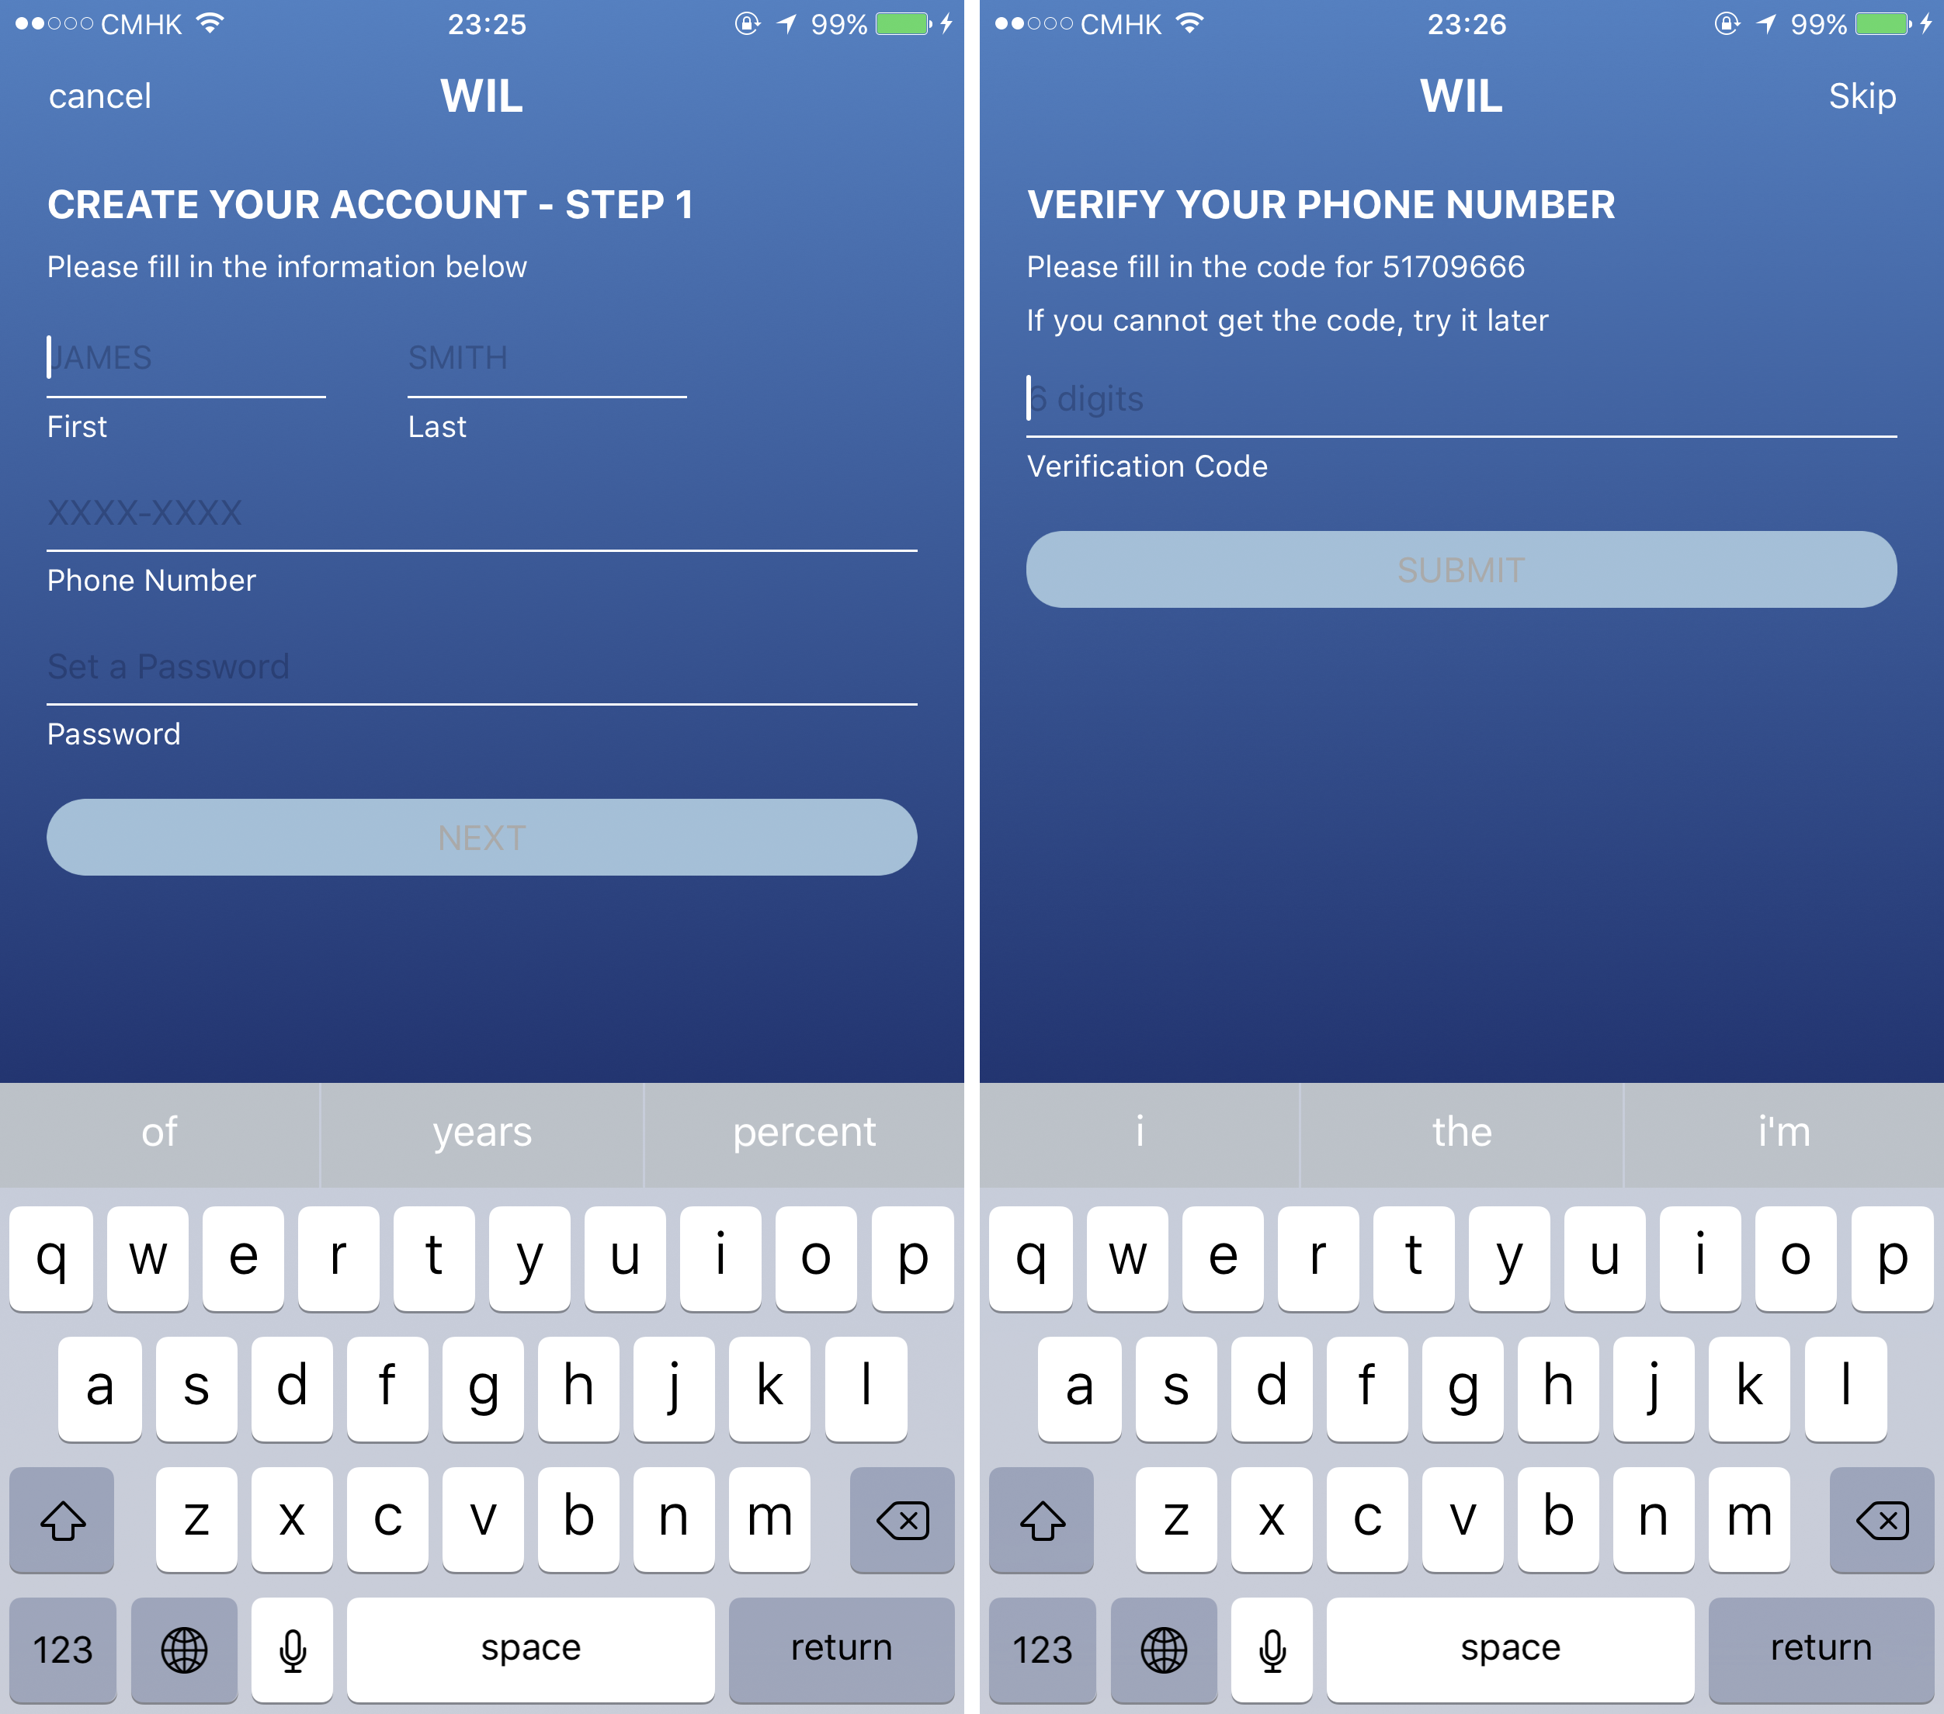
Views – Sign Up Pages

Slide 28
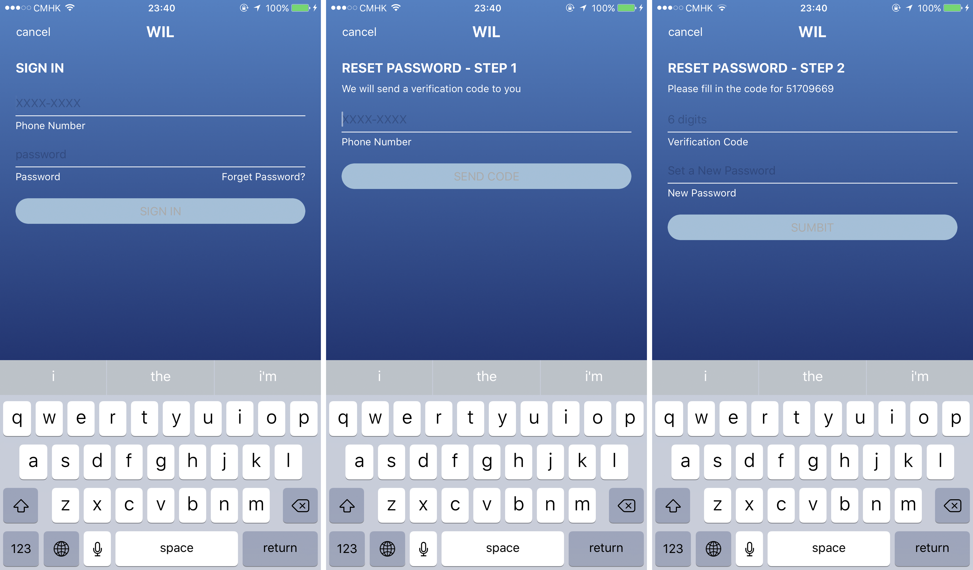
Views – Sign In Page and Reset Password Pages

Slide 29
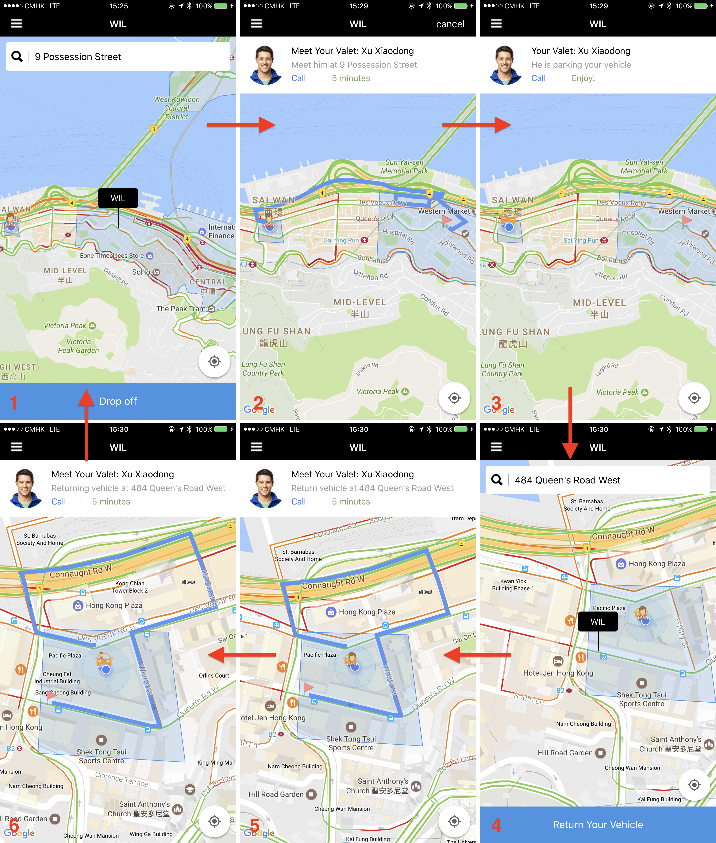
Views – Main Page

Slide 30
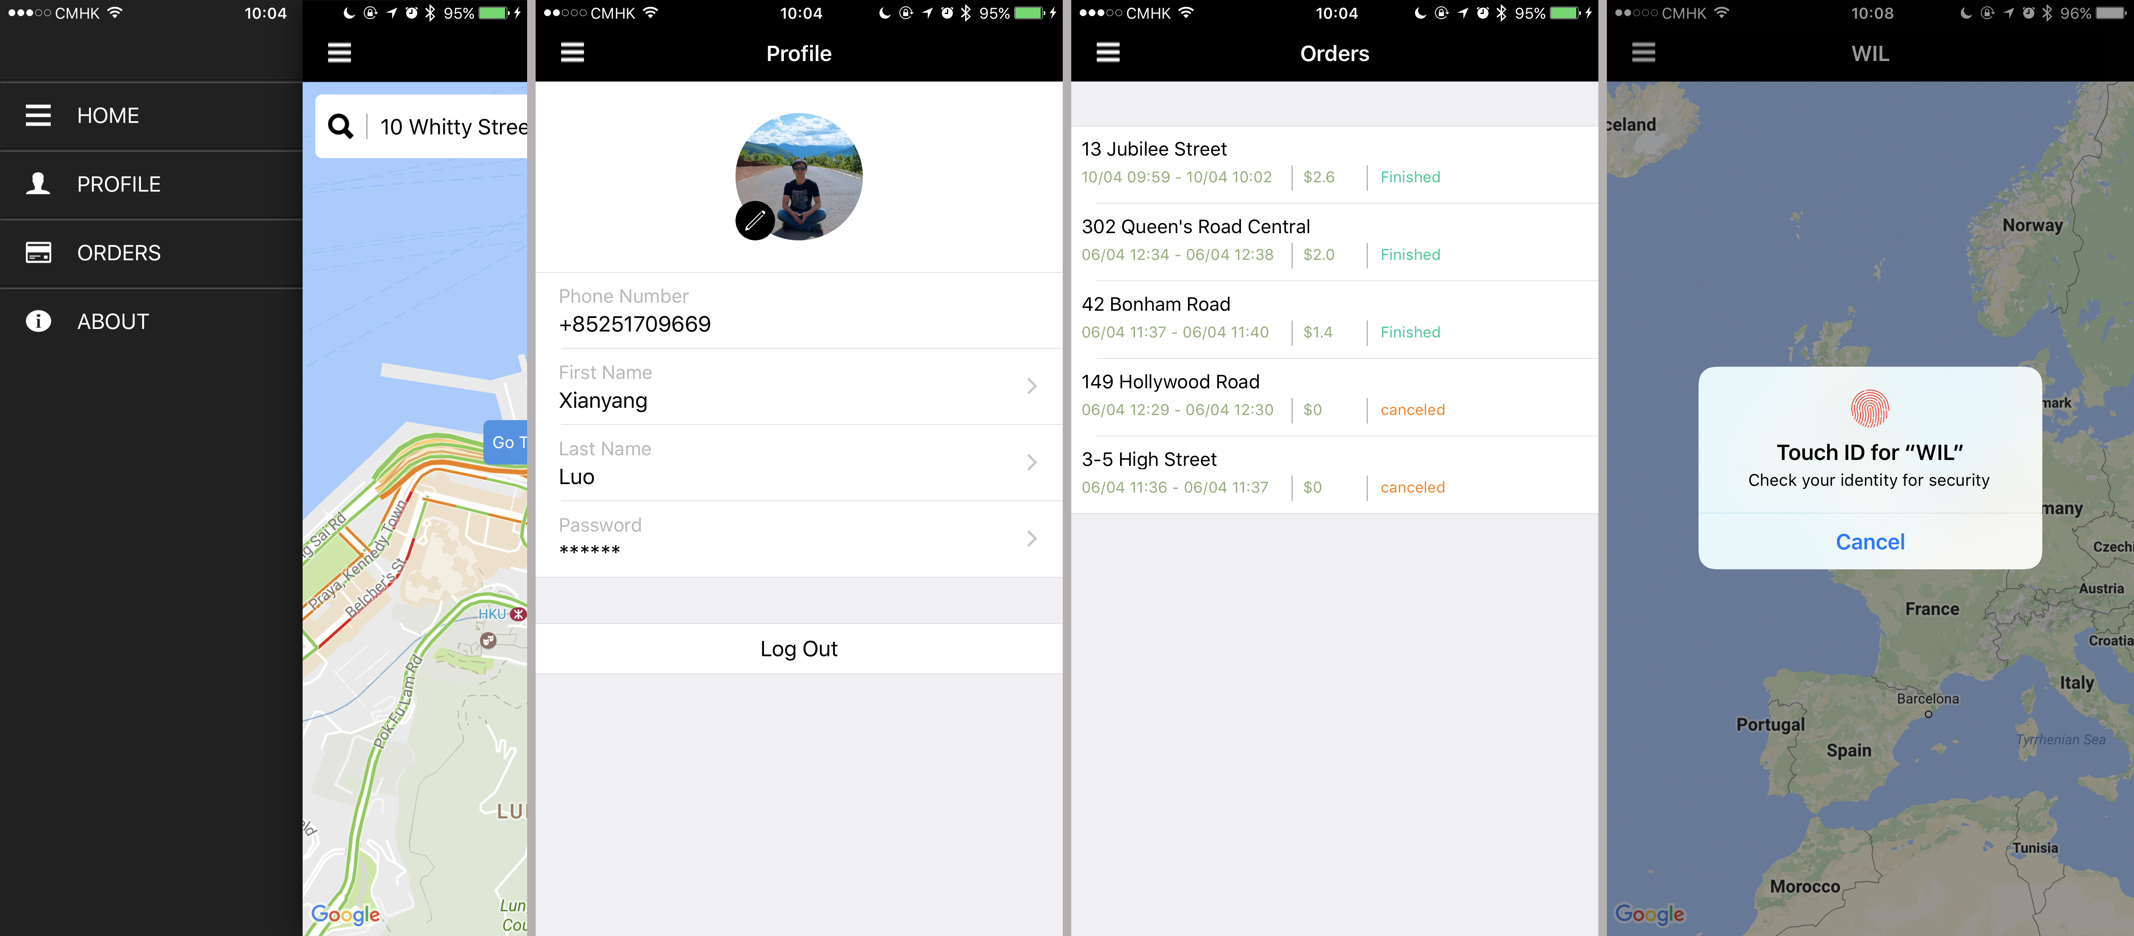
Views – Menu Pages

Slide 31
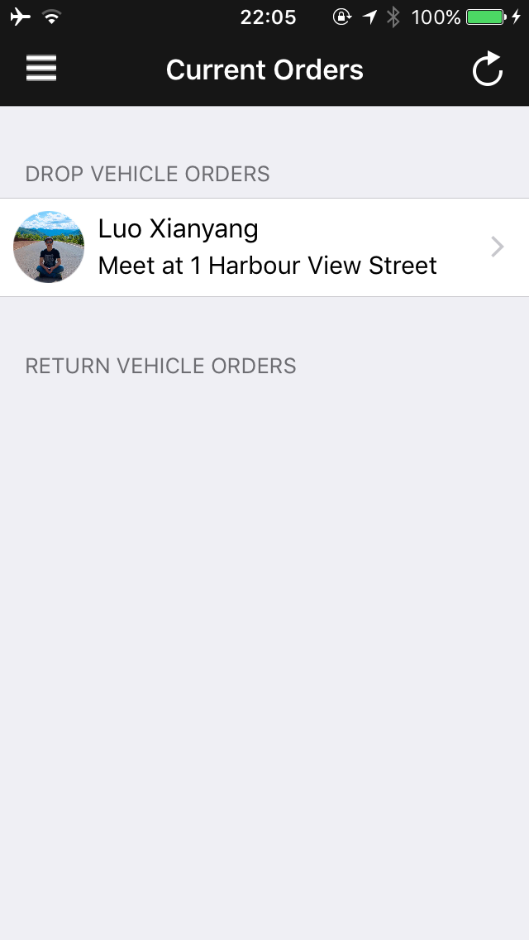
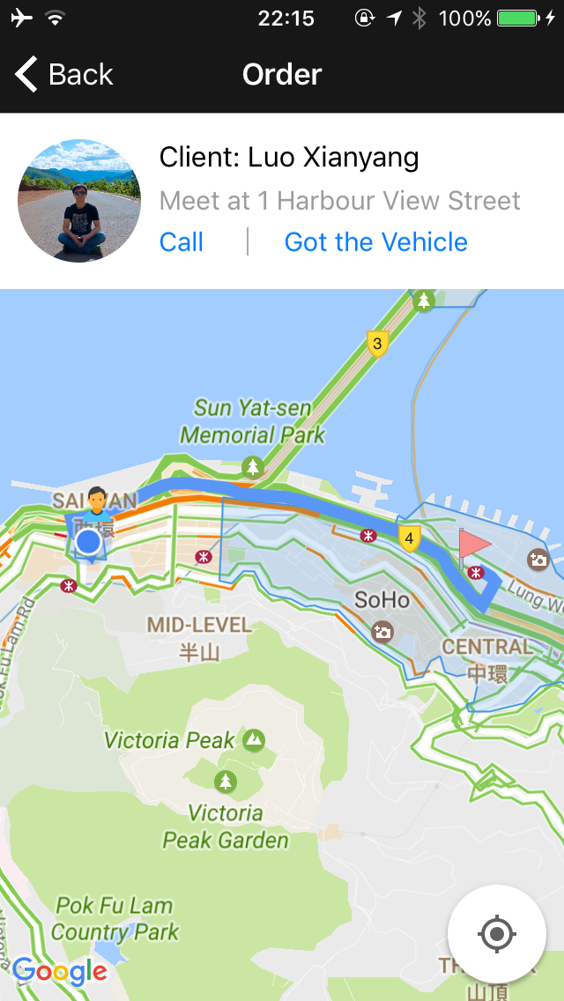
Views – Valet Client Main Views

Slide 32
Future Work
Offer additional services like washing, refueling
Social Network
Apple watch
Insurance

Slide 33
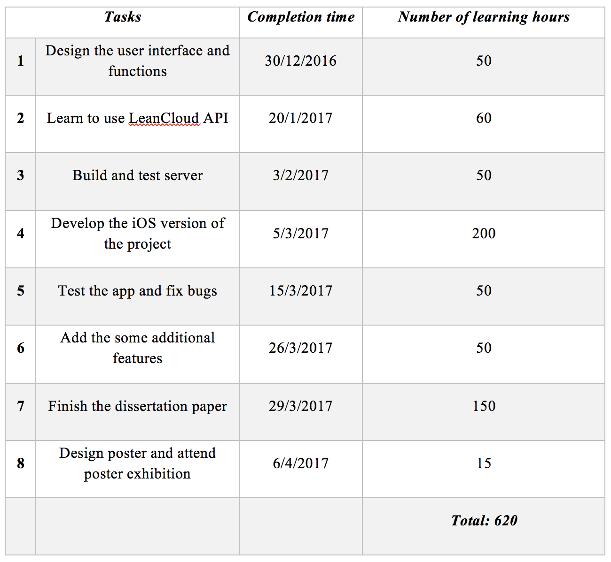
Time

Slide 34
Demo

